Slide 1

Brreg Lookup
Solution and architecture
Av: Anders Torgersen

Slide 2
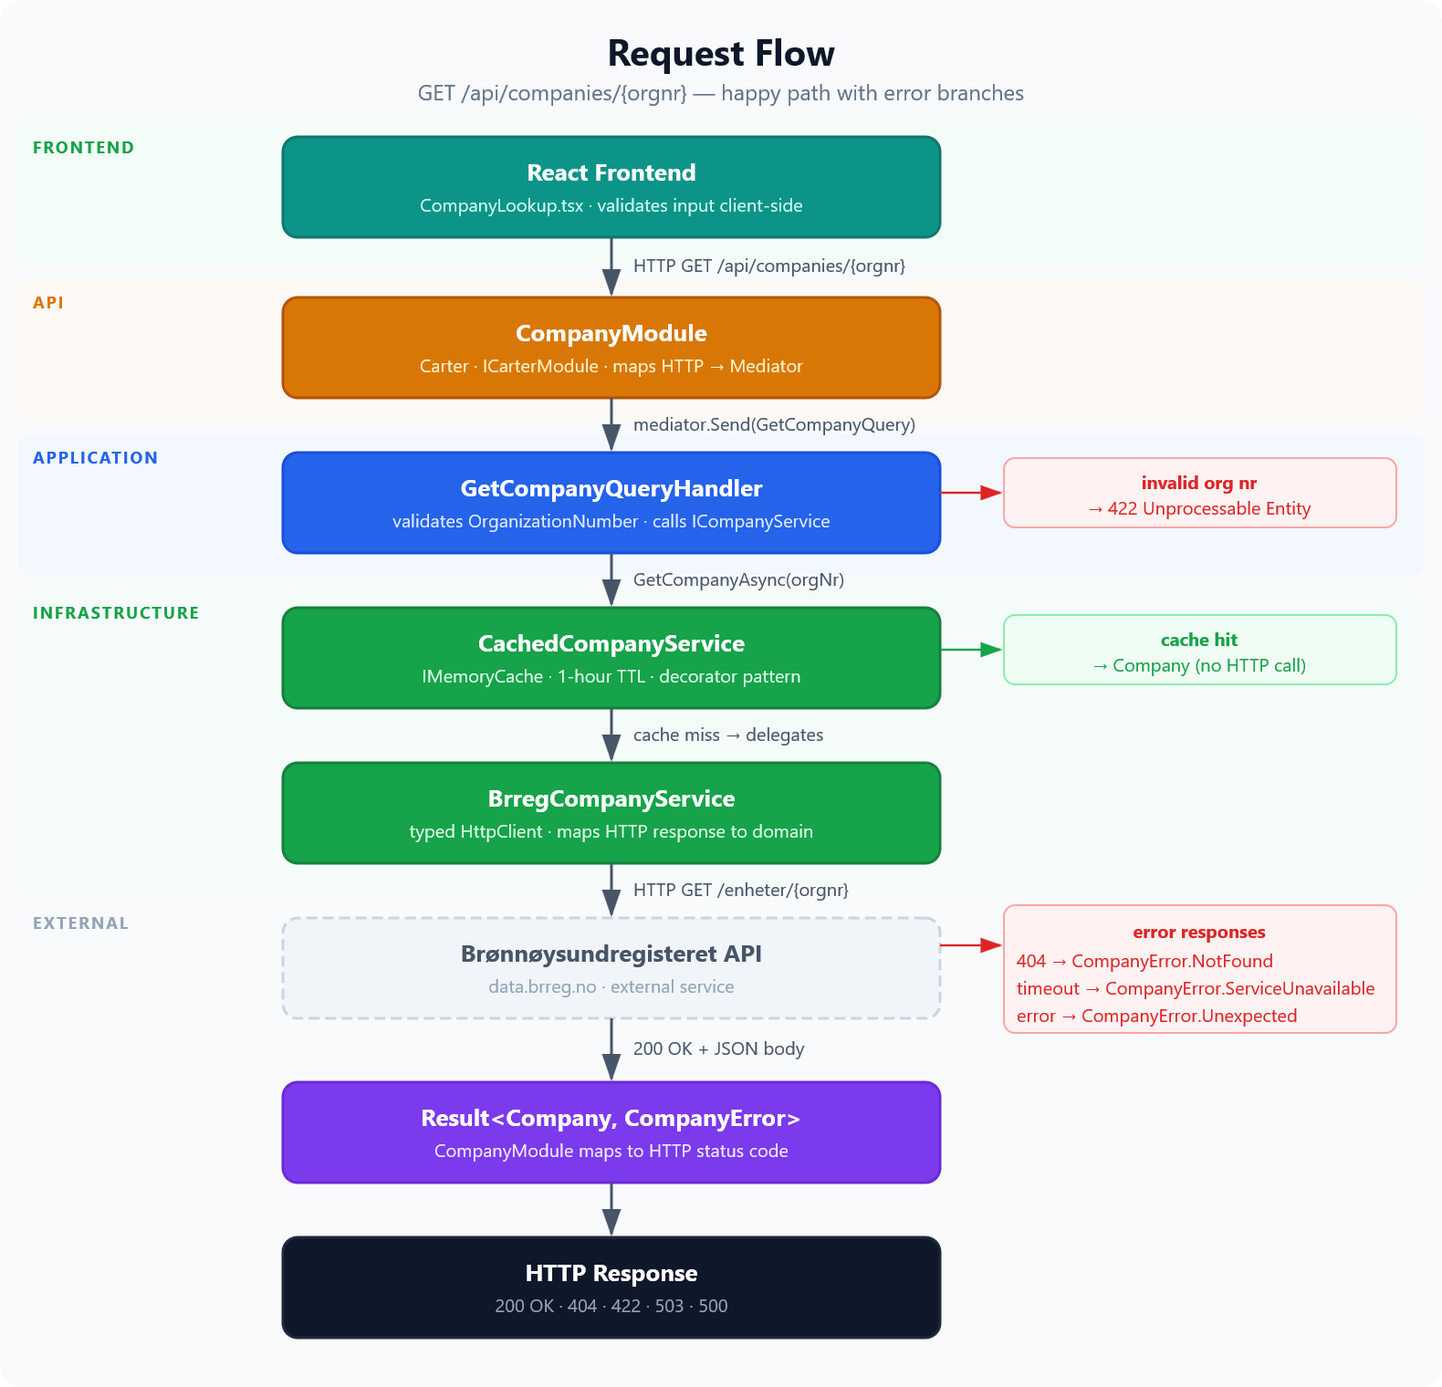
The Flow

Slide 3
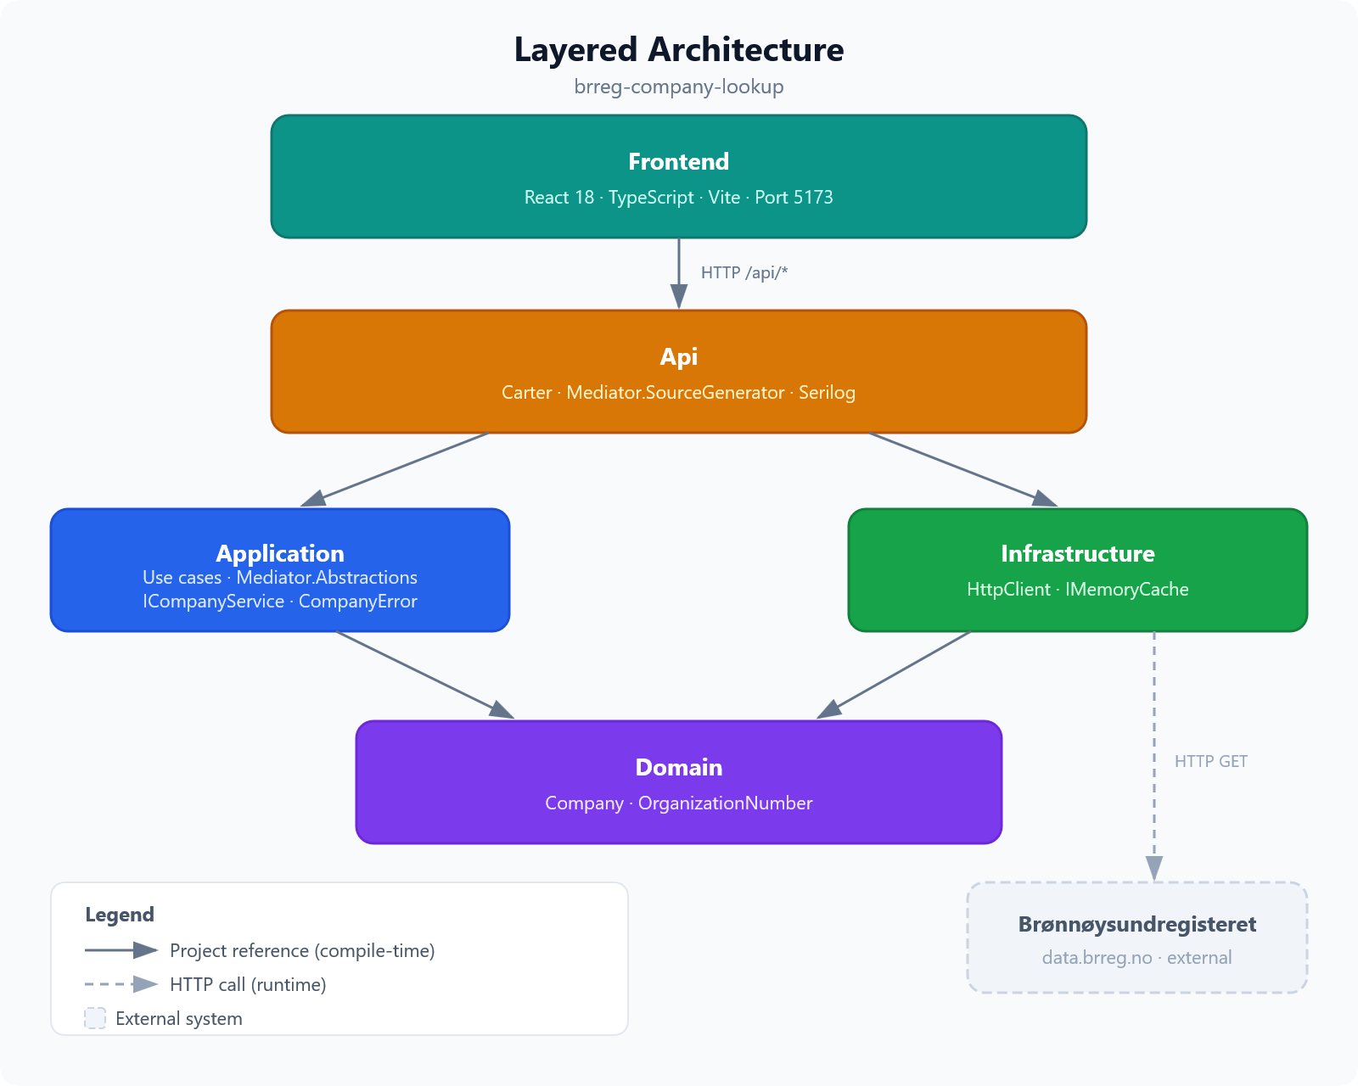
Architecture

Slide 4
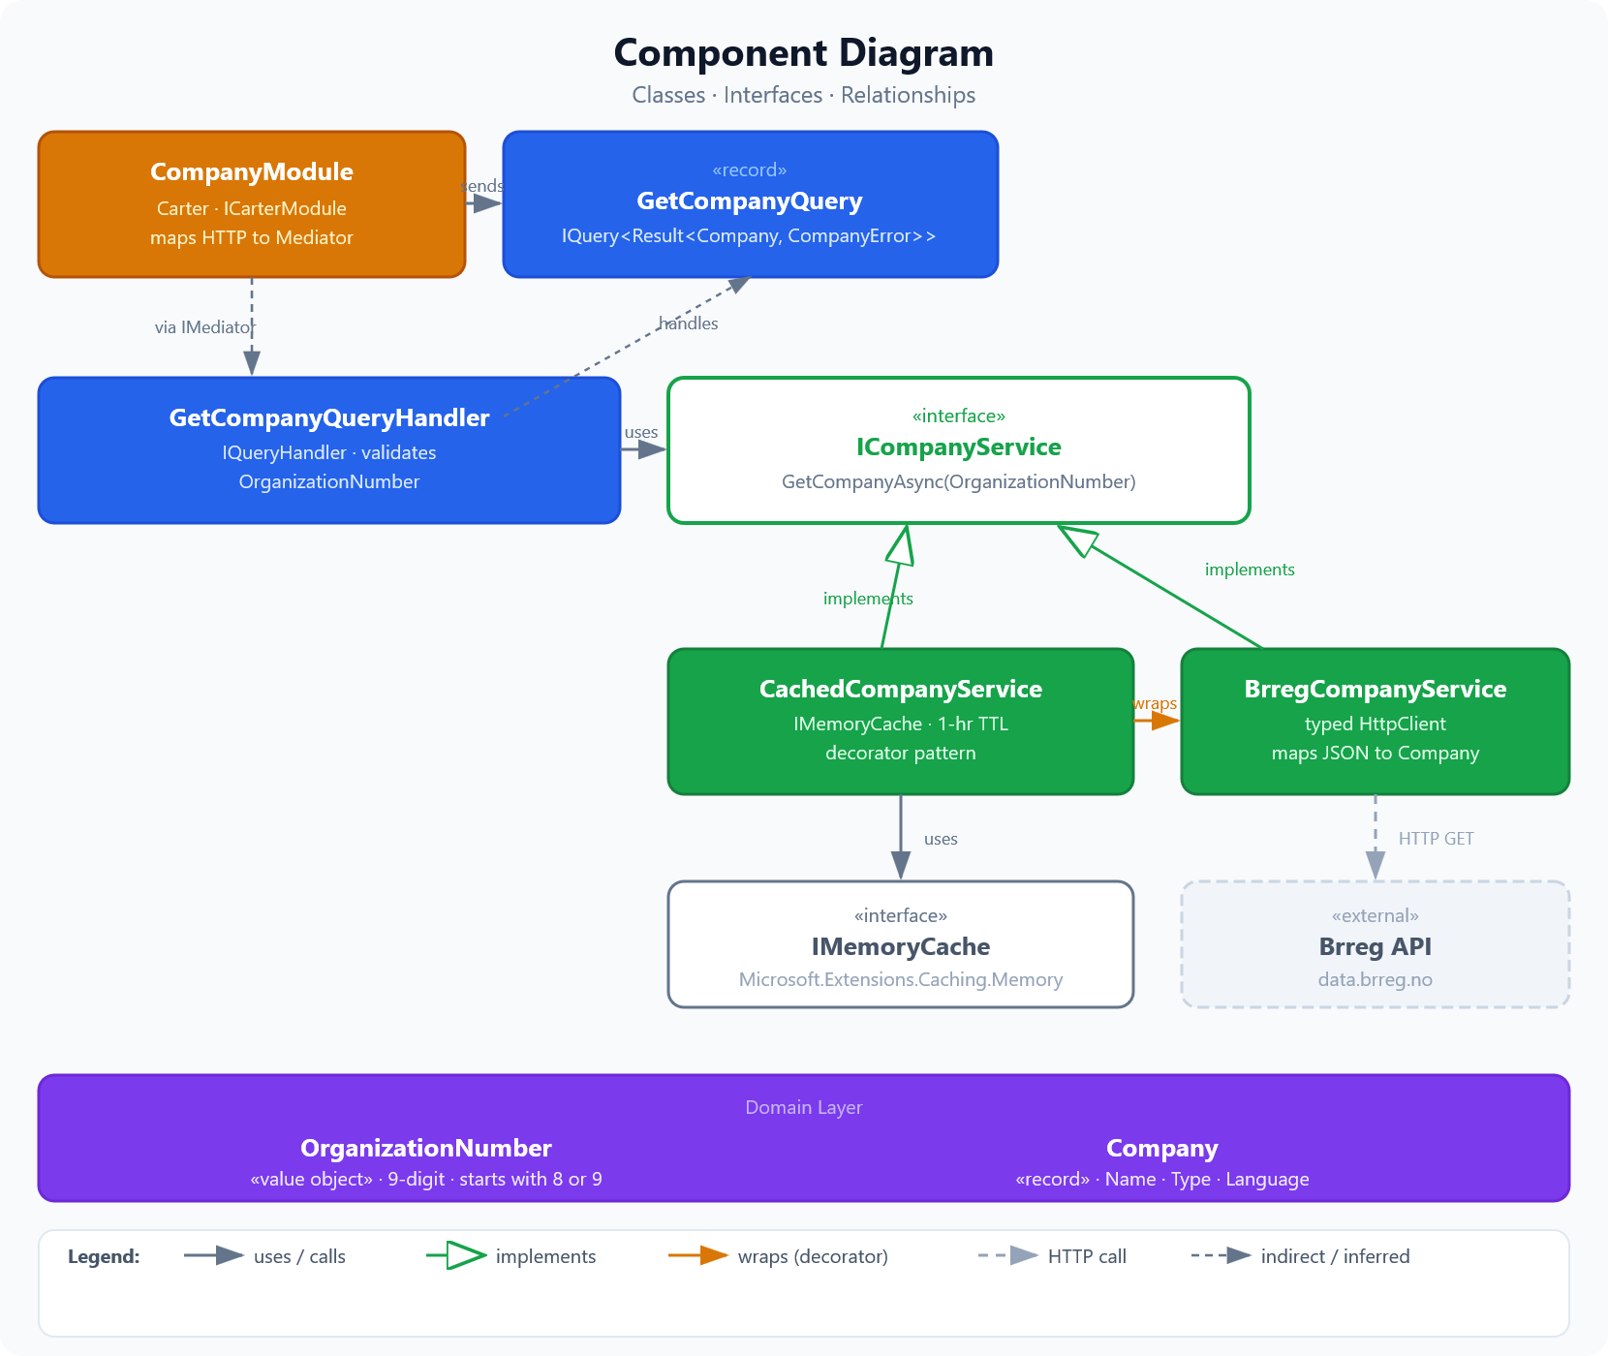
Components

